Slide 1
The Realization of Robot Theater: Humanoid Robots and Theatric Performance
Student-Led Discussion
Presented by Sadeq Alkhoori

Slide 2
Discussion Question 1:
Based on the reading, how do you think “Performing Robots” are important in theatres?

Slide 3
Quote
“While modern technology is bringing huge stress to human life, it is worthy to build entertaining robots for providing laughter to human.”

Slide 4
What is the difference between Technology and Performing Robots?
SONY QRIO:
https://www.youtube.com/watch?v=OVV5AoRK2j4
Wakamaru Robot:
https://www.youtube.com/watch?v=nlJgmWTQSk8
Kaspar Robot:
https://www.youtube.com/watch?v=wT0RtnCR13o
Android Robot, Asuna:
https://www.youtube.com/watch?v=-gOWtdY-OMY

Slide 5
Discussion Question 2:
Based on the linked videos from the reading, how do you think the four robots are different from each other? How can you describe their personality? And, how did the audience respond to them?

Slide 6
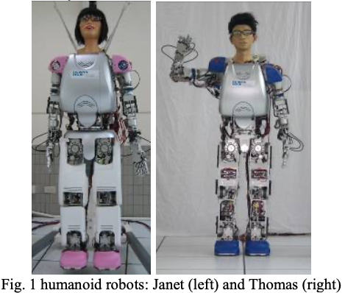
What does performing robots really convey?
“Janet and Thomas, the two androids, perform a musical section from “The Phantom of the Opera” . . . showing that robots may express love and with emotions. The culminating music and dance are combined with Ringo’s, the second wheeled robot, drumming and Janet and Thomas’ dancing, illustrating joy in the robot world. ”

Slide 7
Discussion Question 3:
“By 2025, there will be robots in every family” Bill Gates
Do you think that we are likely to have robots in our houses in 5 years? If that was the case, do you think that robots will look like humans in their appearance or simply a performative tool for fun?

